Slide 1
Philosophy for Teachers (P4T):
Developing new teachers’ applied ethical decision-making
Janet Orchard
Ruth Heilbronn
Carrie Winstanley

Slide 2
Ethical deliberation - a marginalised area in teacher education
How and when do trainees learn this requirement?
‘… maintain good relationships with pupils, exercise appropriate authority, and act decisively when necessary’ (DfE, 2011:7)
Developing professional judgement as a professional learning community within a ‘safe emotional space’
Notes:
Our aims were to:
Consider typical examples of complex classroom situations and challenging behaviour
Professional development (in dialogic work) for teacher educators
Provide space and time for critical reflection
Enable student teachers to think ethically about dilemmas they might face in the classroom
Help build independence and confidence
Encourage systematic thinking about education

Slide 3
Project evolving through work with teacher educators
Residential workshops adopting a dialogic approach, using student-generated narratives (rather than ‘set piece’ role-plays)

Slide 4
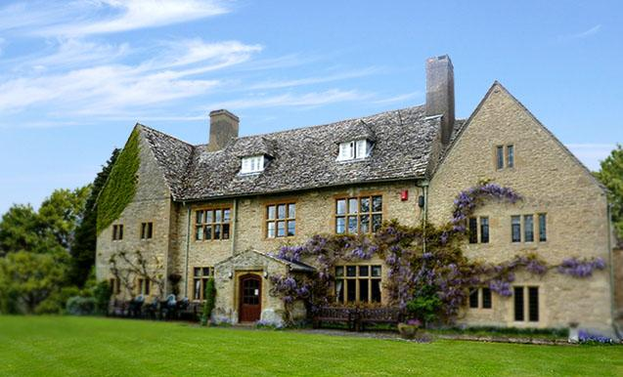
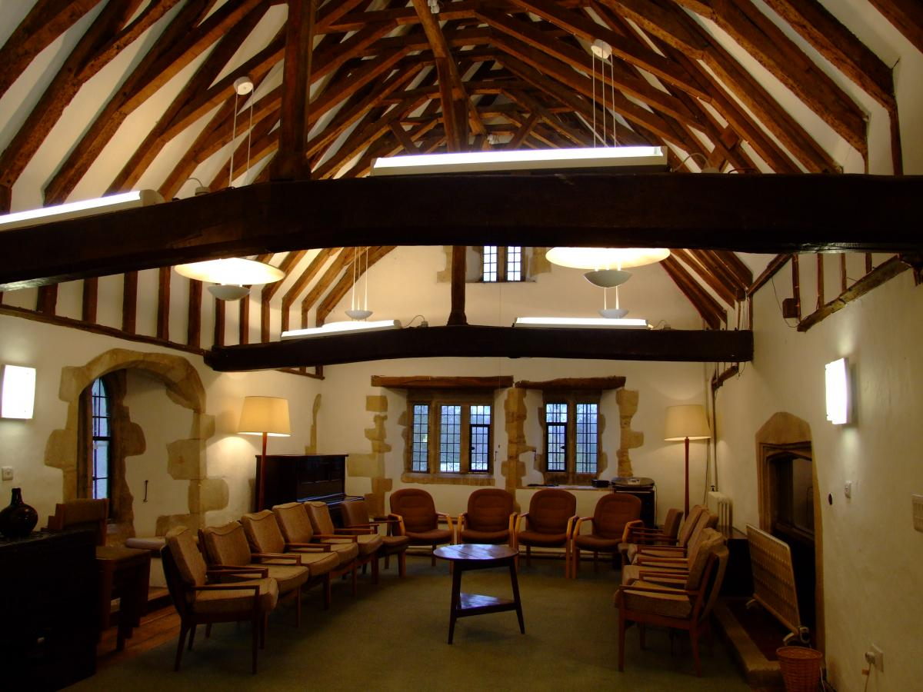
Space and time
Charney Manor
24-hour residential in a calm, shared place…
…allowing participants to escape from the 'busyness' in school

Slide 5
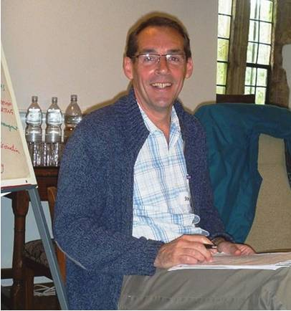
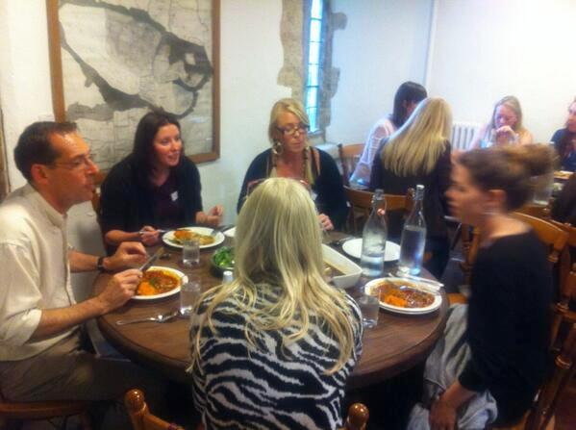
‘P4T’ Communities of Enquiry - Inclusive, non-judgemental teaching (Haynes et al, 2015)
Participants:
- students and tutors
- philosophers of education (gadflies/ stingrays)
- trained and experienced facilitator
Notes:
Role of philosophers of education: to intervene if/when challenges were appropriate ; to contribute; to develop nuance in arguments; to avoid ethical ‘cul de sacs’.
OUR COMMUNITIES OF ENQUIRY:
Thought-provoking ‘texts’ (created or chosen) – questions for enquiry were created from trainee teachers’ experiences
These questions formed the ‘agenda’ in a cyclical process of questioning, reasoning and reflection
Facilitator’s stance is fallibilistic, open-ended, tactful, self-effacing challenging, responsive
Outcomes of enquiry not known in advance

Slide 6
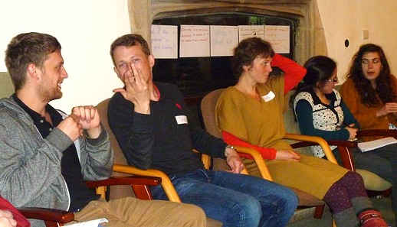
Tackling ‘big’ ethical concepts,
such as fairness, respect, trust and equity
‘Stretching concepts’ with slow and deliberate interrogation of ideas through debate
Notes:
Stretching concepts reveals depth, ambiguity and complexity of ideas
(Examining existential anxieties)

Slide 7
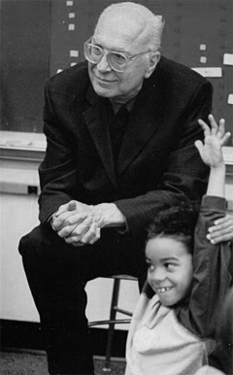
‘students listen to one another with respect,
build on one another’s ideas,
challenge one another to supply reasons for otherwise unsupported opinions,
assist each other in drawing inferences from what has been said, and
seek to identify one another’s assumptions.’
Matthew Lipman
(1991:15)
Notes:
Lipman was influenced by Vygotsky, Piaget and Dewey as well as the tradition of Socratic dialogue
The creation of the community links to the Freirean notion of participatory democracy

Slide 8
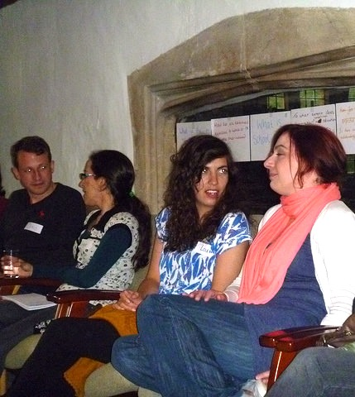
Logical and critical thinking…
Participants enquire, build hypotheses,
consider consequences etc
Dialogue and thinking should be rigorous and disciplined using criteria and thus self-correction

Slide 9
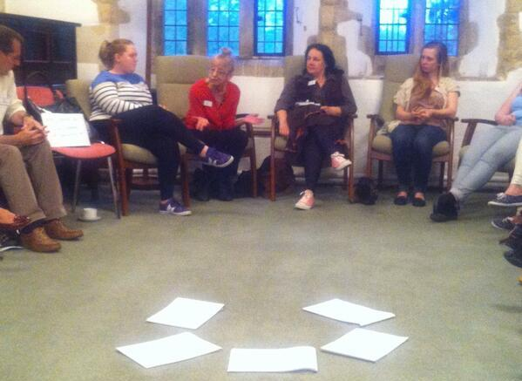
Key outcomes
- demand and need for the activity
- success of the pedagogic model
- fusion of theory and practice
- ontological issues in ITE
Students particularly valued – the quality of the experience and the range of discussion
Tutors particularly valued – the use of reflective methodologies

Slide 10
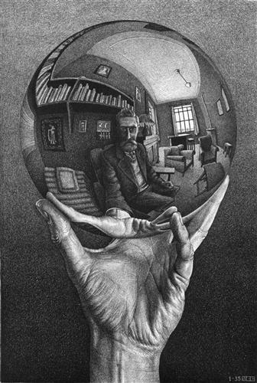
Partners in the development of ethical decision-making through reflective residential workshops

Slide 11
Want to find out more?
Orchard, J, Heilbronn, R. & Winstanley, C. (2016) ‘Philosophy for Teachers (P4T) - Developing new teachers’ applied ethical decision making’, Ethics and Education 11.1
Email me for an electronic copy: edjlo@bristol.ac.uk

